Slide 1
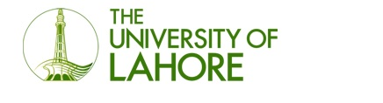
SMS Spamming Application
By
Ibrahim Irfan – CSU-F15-104
Bilal Ahmed– CSU-F15-105
Notes:
Assalam o alaikum sir my name is Mirza Faraz Hassan and these are my group members Shawaal Saif and Anam Bibi . We are from Bscs 8th semester and working under the supervision of Dr Jawad and our co supervisor is Sir usman ahmed. We are about to discuss our project that is curriculum vitae analysis.

Slide 2
Outline
Introduction
Problem Statement
Use Case Diagram
Sequence Diagram
Activity Diagram
Data Flow Diagram
Component Diagram
State Diagram
Future Work
Conclusion
Notes:
In this presentation we are going to discuss about our project. First we will go through introduction then we will identify which problem we are solving. We have also done some literature review. After we will discuss design of our project. The given timeline is also included.

Slide 3
Introduction
SMS spamming application is a project that will facilitate the prevention of unwanted SMS messages or pop up ads to appear on a user’s Android smartphone.
Users will be able to download a free of cost app from the Play Store that will allow them to avoid unwanted messages or spams and block any ads that can harm their device.
Notes:
We are developing a system which will analyze bulk of CVs . The system will process pdf format and process text from the files .The analyzed text will be evaluated by different machine learning approaches and result will be generated. Database will be created and then the data would be retrieved.

Slide 4
Scope
The scope of this project is to develop and design an Android based app that will be able to scan and detect SMS spams stored on a user’s Android smartphone and will provide the results

Slide 5
Methodology
We will work in Java and Python
Collect spam datasets
Create AI based model using spam datasets in Random Forest and SVM
Create GUI in Android Studio

Slide 6
Problem Statement
For quite some time now, many individuals all around the world do most of their work on their Android smartphones and have become very fond of the technology.
In the modern era, most users keep all their data such as contacts, messages, accounts (usernames and passwords), and images on their Android device.
However, recently a lot of smartphone users have had to deal with the frustration of unwanted SMSs, spams and pop ads interfering in their work.
Most people don’t even know the origin of these spams and what harm they may bring. These spams are not only irritating but can also harm your device in many ways.
Notes:
Whenever there is a vacant position in some organizational structure. The organization wants to heir the most suitable candidate for that vacant position. The process of hiring someone is quite extensive . There are so many CVs which a company receives against that position. To analyze each CV and chose required candidate for the job is a complex task and needs a lot of time. The process consumes much of time of an organization. There are few systems which were being developed but either they are organization dependent systems or they cant handle huge data.

Slide 7
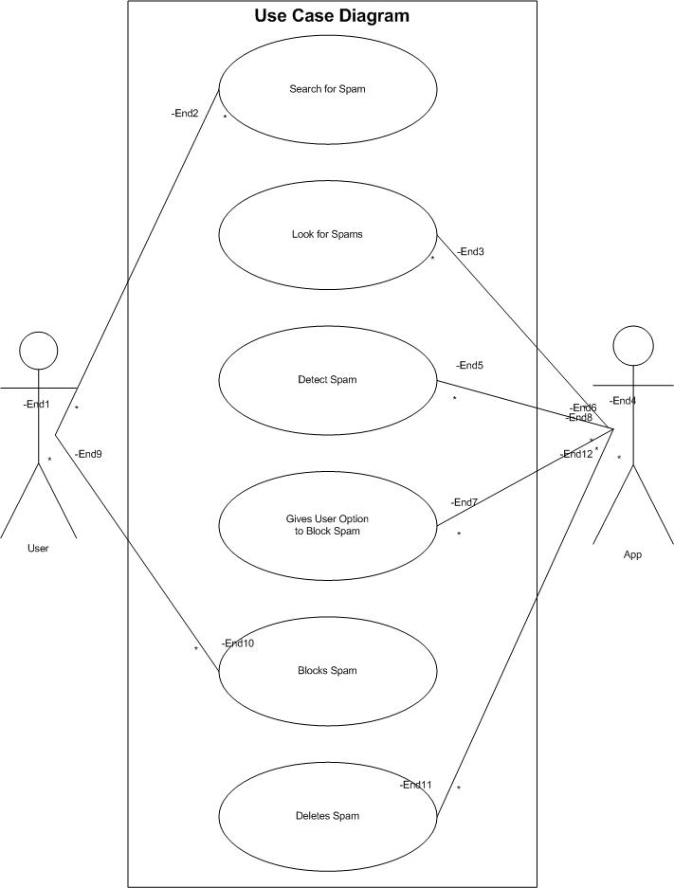
Use Case Diagram

Slide 8
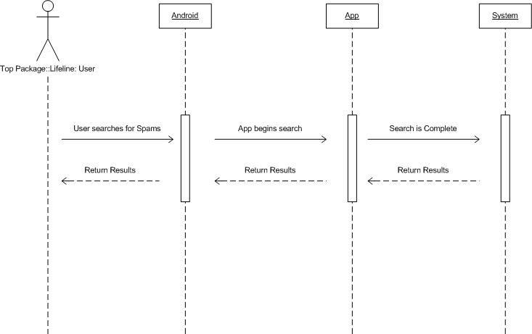
Sequence Diagram

Slide 9
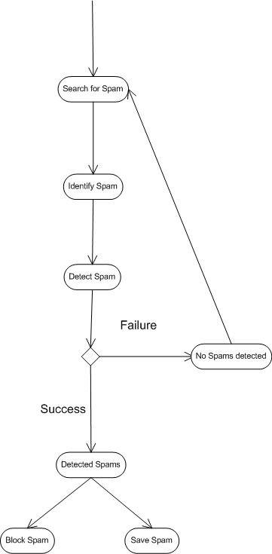
Activity Diagram

Slide 10
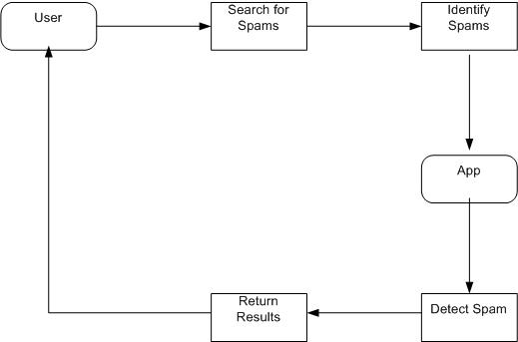
DFD

Slide 11
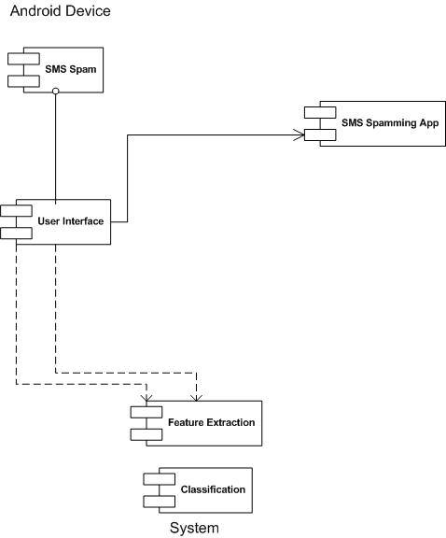
Component Diagram

Slide 12
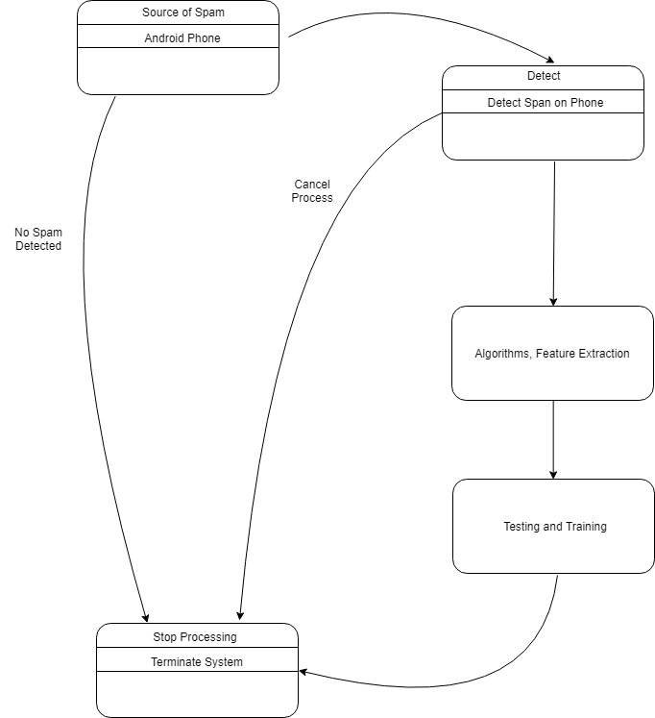
State Diagram

Slide 13
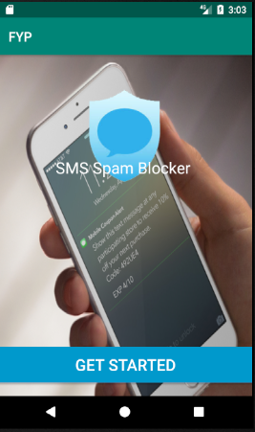

Slide 14

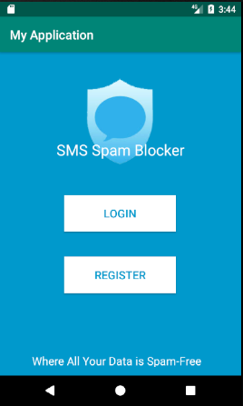

Slide 15
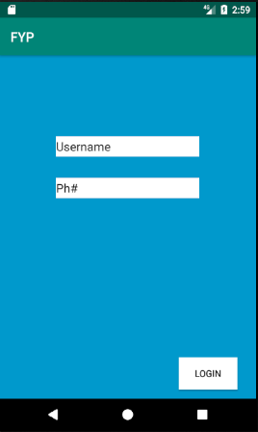
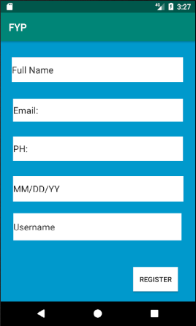

Slide 16
Future Work
Once our GUI is complete, we will create and AI based model in Python which will later be embedded into our app.
This model will be created and implemented using Random Forest and SVM (Support Vector Machine).

Slide 17
Conclusion
Once our project is complete, Android users will have the ability to download a free of cost on their respective devices and make sure that all their important data remains secure.
Notes:
Tom young et al published their paper in 2017 they compared different models and did detail analysis of deep learning in nlp. CNN RNN and recursive neural network are used.in text processing unlabeled data require advance unsupervised or supervised approaches. zero shot learning should be employed where is not much labelled data. Deep learning research should be done in order to better use unlabeled data. The paper presented in 2016 said that Softmax regression is generated from logistic regression for multi-classification problems because its easy to use. DBN is used because it uses a portion of labeled data for fine-tuning in the training process we could obtain a more accurate model with global optimization . Therefore they proposed a novel hybrid model of both DBN and Softmax regression.

Slide 18
Thank You

